Slide 1



DEPARTMENT OF COMPUTER SCIENCE AND ENGINEERING
Major Project (COM-811) Presentation
B.Tech CSE 8th | Batch 2021-2025
Echonav: A Smart Wearable Navigation Aid for the Visually Impaired with Real-Time Obstacle Detection and Voice Guidance
Team Members:
Arjun Kapoor 2021a1r061
Madhu Bala 2021a1r077
Manmeet Kour 2021a1r090
Rachna Sharma 2021a1r078
Isha Choudhary 2022a1l018
Model Institute of Engineering & Technology (Autonomous)
Notes:
Presentation slide for courses, classes, lectures et al.

Slide 2

Table of Content
Introduction & Problem Statement
Project Objectives
Proposed Solution & Innovation
Methodology (Technology Stack)
System Architecture / Workflow
Implementation
Results / Outcomes
Conclusion
References

Slide 3
Introduction
Echonav is a smart wearable device designed to help visually impaired individuals navigate safely and independently.
It uses real-time obstacle detection and voice guidance to alert the user about nearby objects and guide them through their surroundings.
Echonav is designed to be worn comfortably and works without needing to be held, allowing users to keep their hands free for other tasks like using a cane or carrying items.

Slide 4


Problem Statement
Difficulty in navigating safely without external assistance.
High risk of accidents due to the inability to perceive environmental cues (traffic sounds, obstacles, etc.).
Difficulty in interacting with people and accessing information in public spaces.
Lack of affordable, inclusive, and intuitive assistive technologies.

Slide 5
Project Objectives
To design and develop a wearable assistive device to support independent navigation for visually impaired individuals.
To integrate ultrasonic and LiDAR sensors for real-time detection of obstacles within a specified range, providing immediate haptic feedback.
To implement Bluetooth connectivity for seamless communication between the wearable device and a custom smartphone application.
To incorporate GPS tracking for real-time location awareness and to deliver voice-guided navigation instructions for enhanced user safety.

Slide 6
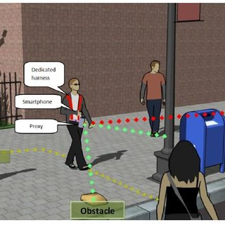
Proposed Solution
Wearable Design
Compact and lightweight device worn on the body (e.g., chest, belt, or shoulder).
Comfortable for daily use without causing strain.
Real-Time Obstacle Detection
Uses ultrasonic or LiDAR sensors to detect nearby obstacles.
Detects objects at various heights (ground level, waist level, head level).
Voice-Based Feedback System
Provides real-time audio alerts to inform the user about obstacles and directions.
Uses simple and clear language for easy understanding.
Hands-Free Operation
Allows the user to move freely without holding any device.
Complements traditional aids like a white cane or guide dog.
Rechargeable and Long Battery Life
Equipped with a rechargeable battery.
Offers long usage time to support all-day navigation.

Slide 7
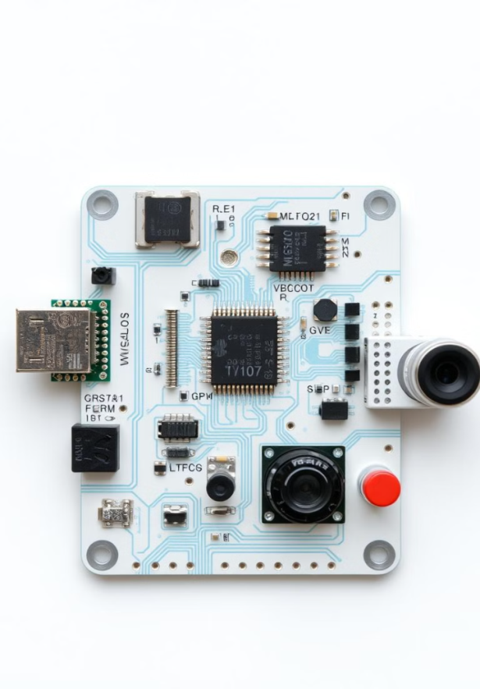
Methodology(Technology Stack): Hardware Components
HC-SR04 Ultrasonic sensor
Maxbotix Ultrasonic sensor(MB1200 XL-MaxSonar-EZ0)
TF-Mini Micro LiDAR
HC-05 Bluetooth module
Arduino UNO
GPS Module
Mini breadboard
Battery 9V
Battery Connectors
Switch ON/OFF
Glove
Buzzer
Jumper wires
Mini breadboard
Vibration Motor

Slide 8
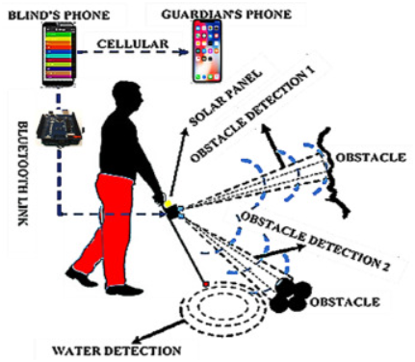
Software Requirements Used
Microcontroller Programming: Python (Arduino IDE)
Bluetooth Communication: Serial Bluetooth
GPS Tracking: Integration with Google Maps API
Obstacle Detection Algorithm: Implements threshold based hap tic feedback.

Slide 9
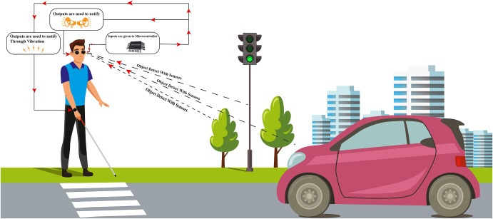
Advanced Features:
Ultrasonic Obstacle Detection – Detects objects at different heights and distances, ensuring complete awareness.
Haptic Feedback System – Provides vibration alerts of varying intensity based on obstacle proximity.
GPS Tracking & Navigation – Helps users navigate safely with real-time location tracking.
Bluetooth Connectivity – Connects with smartphones or smart devices for additional assistance.
Voice Assistance Integration – Can provide audio navigation and alerts via Bluetooth earphones.
Rechargeable & Energy-Efficient – Long battery life with USB charging support.
Lightweight & Wearable Design – Comfortable and easy to use without restricting hand movement.
Emergency SOS Feature – Sends alerts to family or caregivers in case of emergencies.
Weather-Resistant Build – Works in different environmental conditions like rain and dust.

Slide 10
System Architecture:
1. Input Layer: Sensing Environment
Ultrasonic Sensors (HC-SR04, Maxbotix MB1200)
Measure distance to obstacles (front, left, right, top)
LiDAR Sensor (TF-Mini Micro LiDAR)
Detect small/moving obstacles more precisely
GPS Module
Track real-time location outdoors
Bluetooth Module (HC-05)
Communication with smartphone for audio guidance, SOS messaging
2. Processing Layer: Microcontroller Unit
Arduino UNO
Reads sensor inputs
Processes distance calculations
Applies threshold logic for obstacle detection
Controls vibration intensity
Manages Bluetooth data transmission
Handles GPS data parsing
3. Output Layer & Feedback
Haptic Feedback System (Vibration Motors)
Vibrates based on proximity of obstacles (intensity varies)
Audio Feedback System (Voice Assistance)
Sends alerts via Bluetooth to smartphone → played in earphones
Emergency Alert System (SOS)
Sends SOS message with GPS coordinates through connected smartphone.

Slide 11
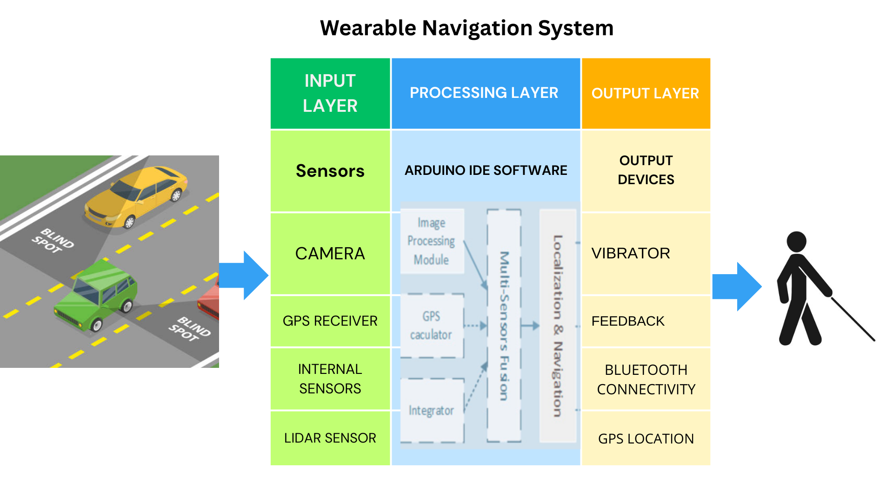
Workflow

Slide 12
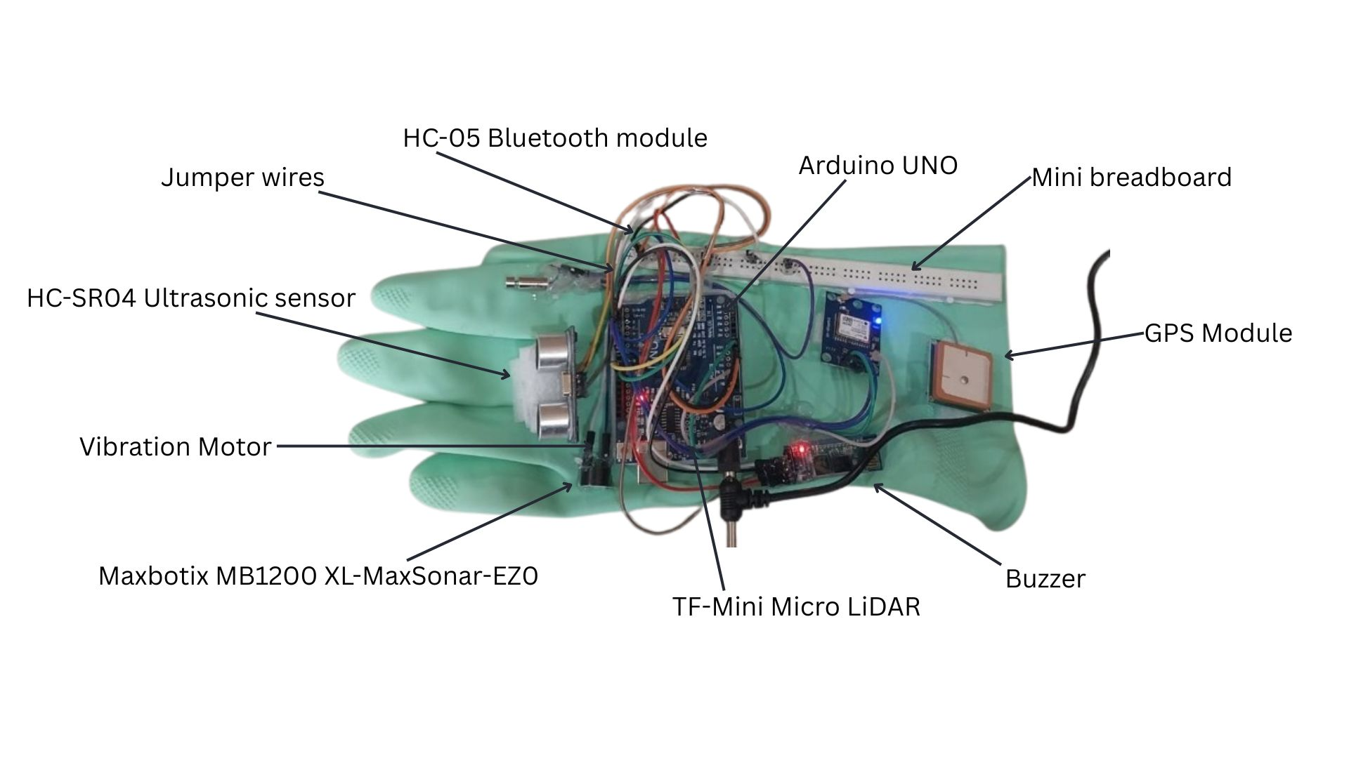
Implementation

Slide 13
Results
The “Visually Impaired" device was successfully designed and implemented, where the ultrasonic sensor accurately detected nearby obstacles and triggered immediate feedback through a vibration motor, resulting in a lightweight, portable, and user-friendly system that enhanced spatial awareness for visually impaired individuals, with optional features like multi-sensor support and audio alerts further improving its effectiveness, making the device an affordable and reliable solution for safe navigation.

Slide 14
Conclusion
Echonav is a smart, wearable navigation aid designed to improve the independence, confidence, and safety of visually impaired individuals. By using real-time obstacle detection and voice guidance, it provides a practical solution for navigating complex environments.
The device is affordable, easy to use, and hands-free, making it a valuable addition to existing mobility tools like the white cane. Through smart technology and user-focused design, Echonav aims to make daily movement safer, more comfortable, and more empowering for those with visual impairments.

Slide 15
References
F. Garcia, P. Crespillo, and J. L. Blanco, “Deep learning-based obstacle detection for visually impaired using wearable vision sys tem,” in 2019 IEEE International Conference on Robotics and Automation (ICRA), 2019, pp. 8859–8865. [Online]. Available: Deep Learning Based Wearable Assistive System for Visually Impaired People
S. Shoval, I. Ulrich, and J. Borenstein, “Computerized guidance sys tem for blind people,” IEEE Transactions on Systems, Man, and Cy bernetics- Part C: Applications and Reviews, vol. 28, no. 3, pp. 303 314, 1998. [Online]. Available: its3.pdf
C. K. Priyadarshini and M. S. Nalini, “IoT-based smart navigation system for visually impaired people,” in 2021 5th International Conference on Computing Methodologies and Communication (ICCMC), 2021, pp. 172–176. [Online]. Available: navigation system
S. Ahmed, T. Nguyen, and M. S. Islam, “A hybrid navigation system for visually impaired using RFID and ultrasonic sensors,” Sensors, vol. 20, no. 15, p. 4282, 2020. [Online]. Available: A Wearable RFID-Based Navigation System for the Visually Impaired

Slide 16
Thank You

